Slide 1




Impact environnemental de la science ouverte à l’ère du numérique prépondérant
Romain ROUVOY
Univ. Lille (CRIStAL) / CNRS / Inria

Slide 2
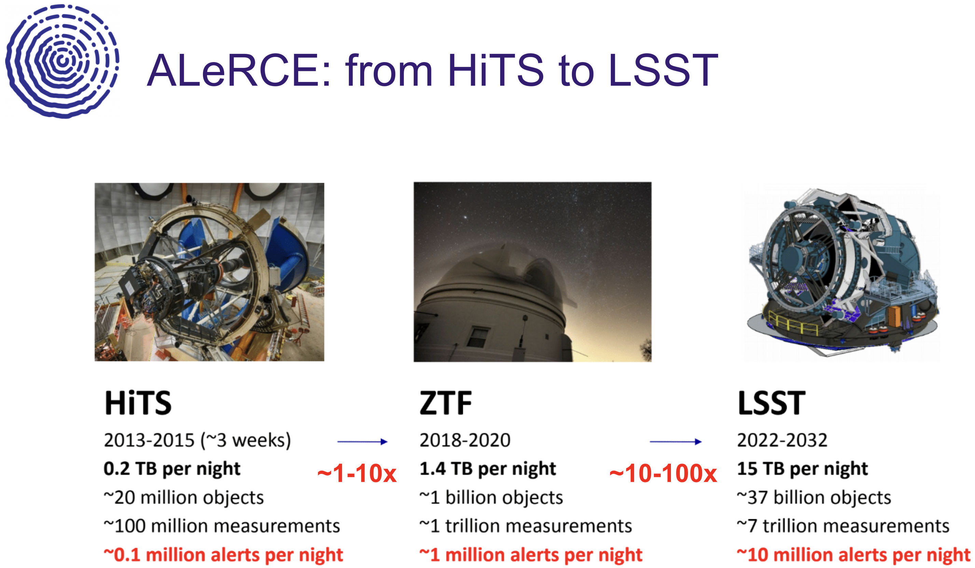
Source: https://alerce.science

Slide 3


Slide 4
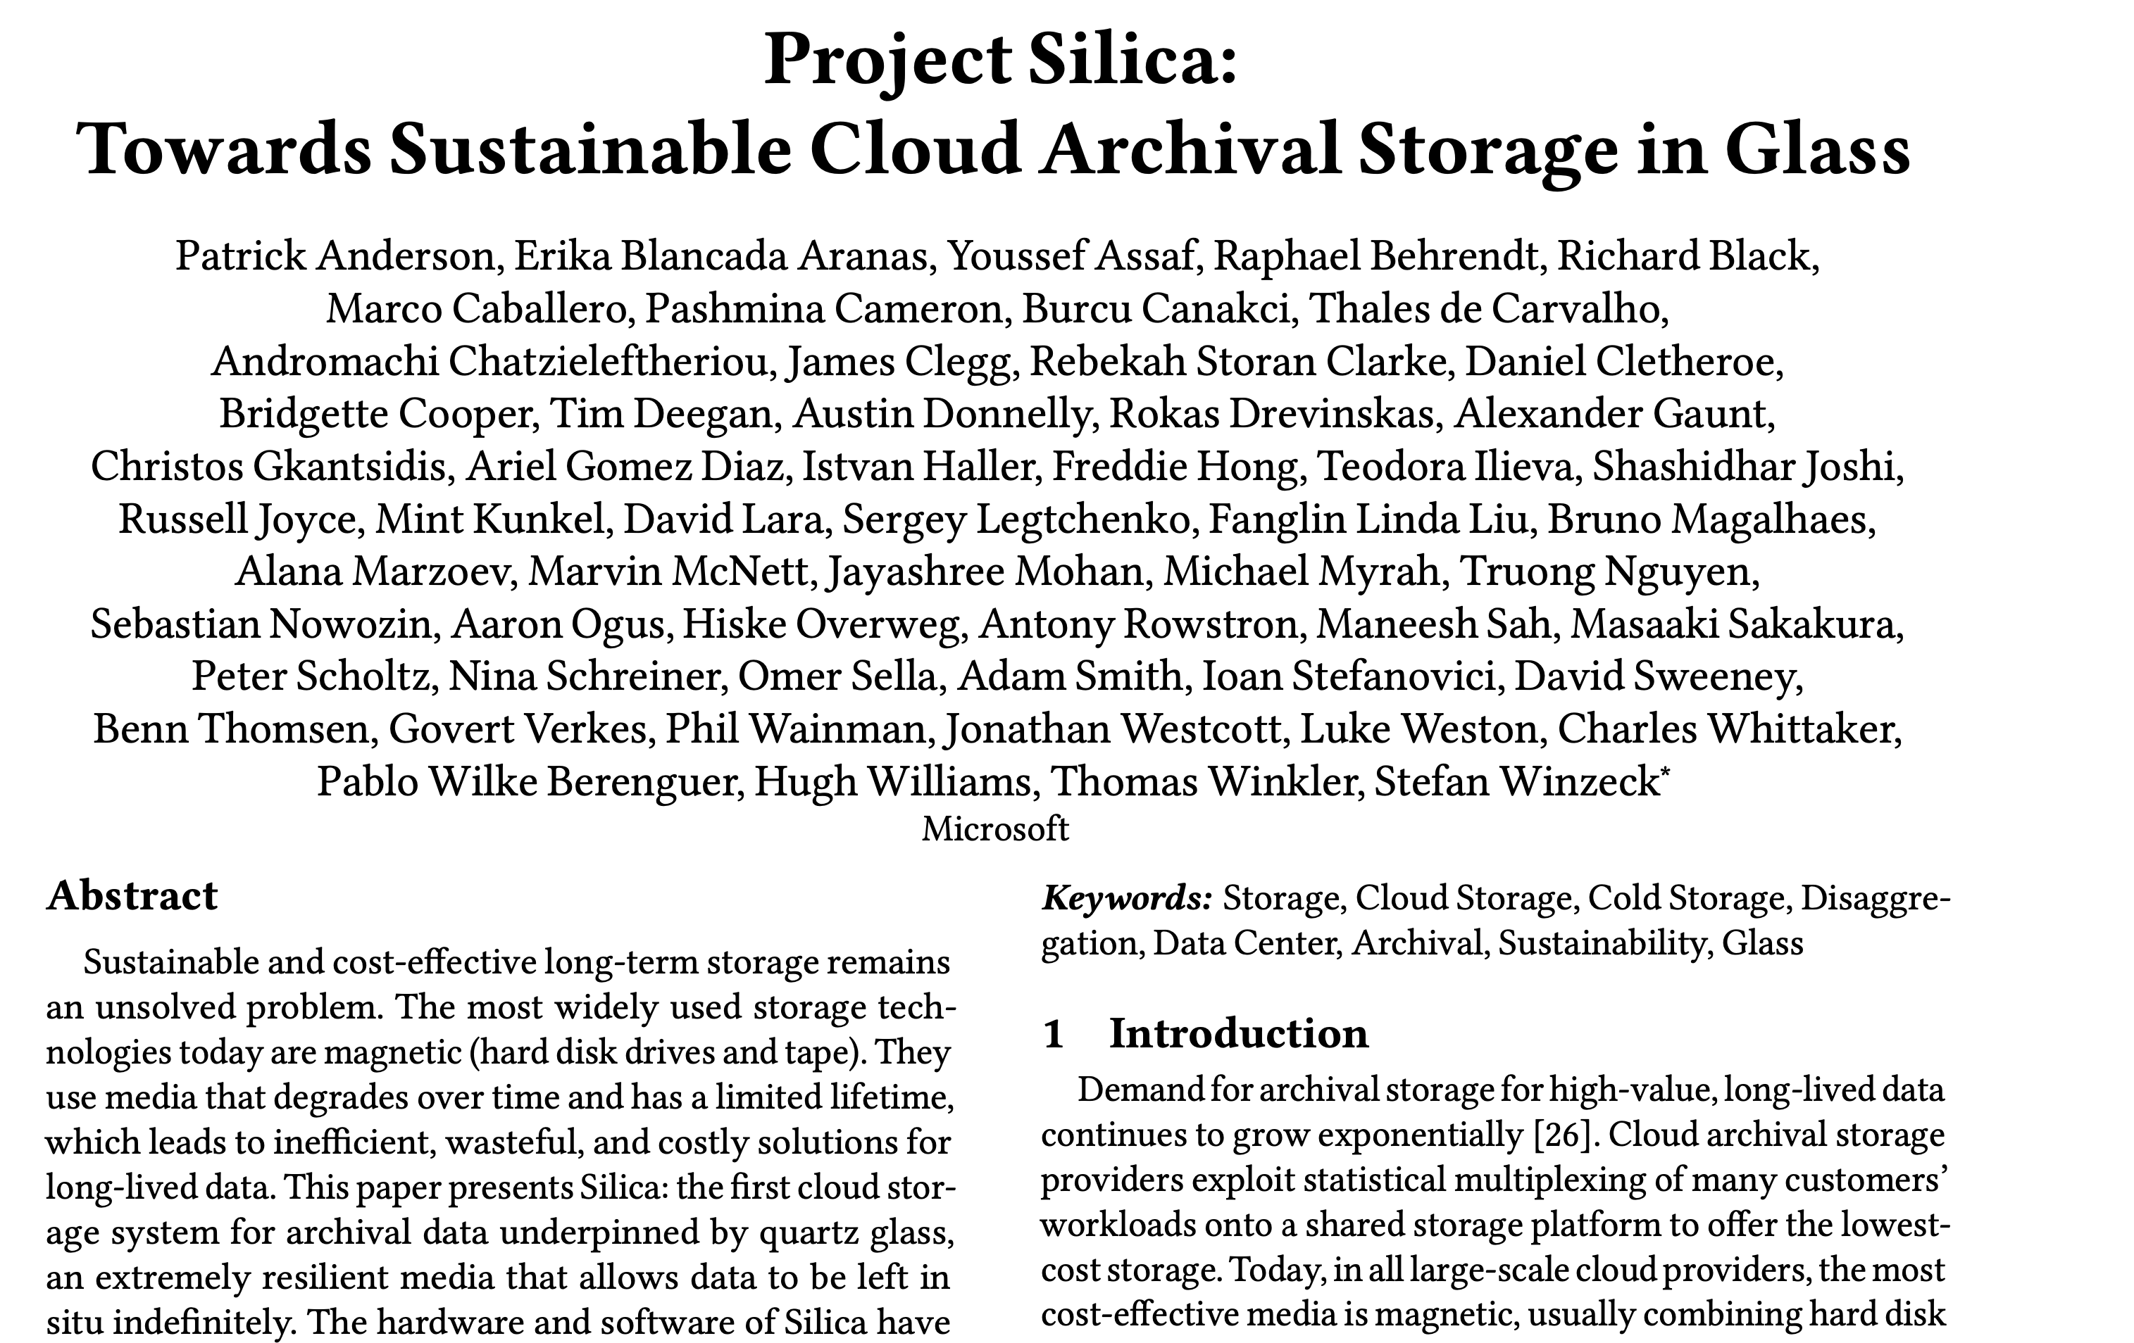
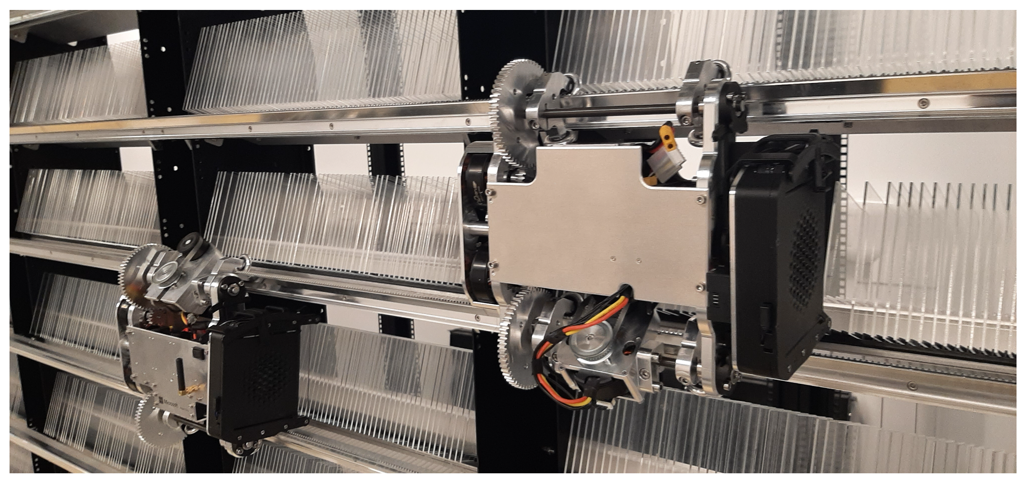
Source : https://doi.org/10.1145/3600006.3613208

Slide 5
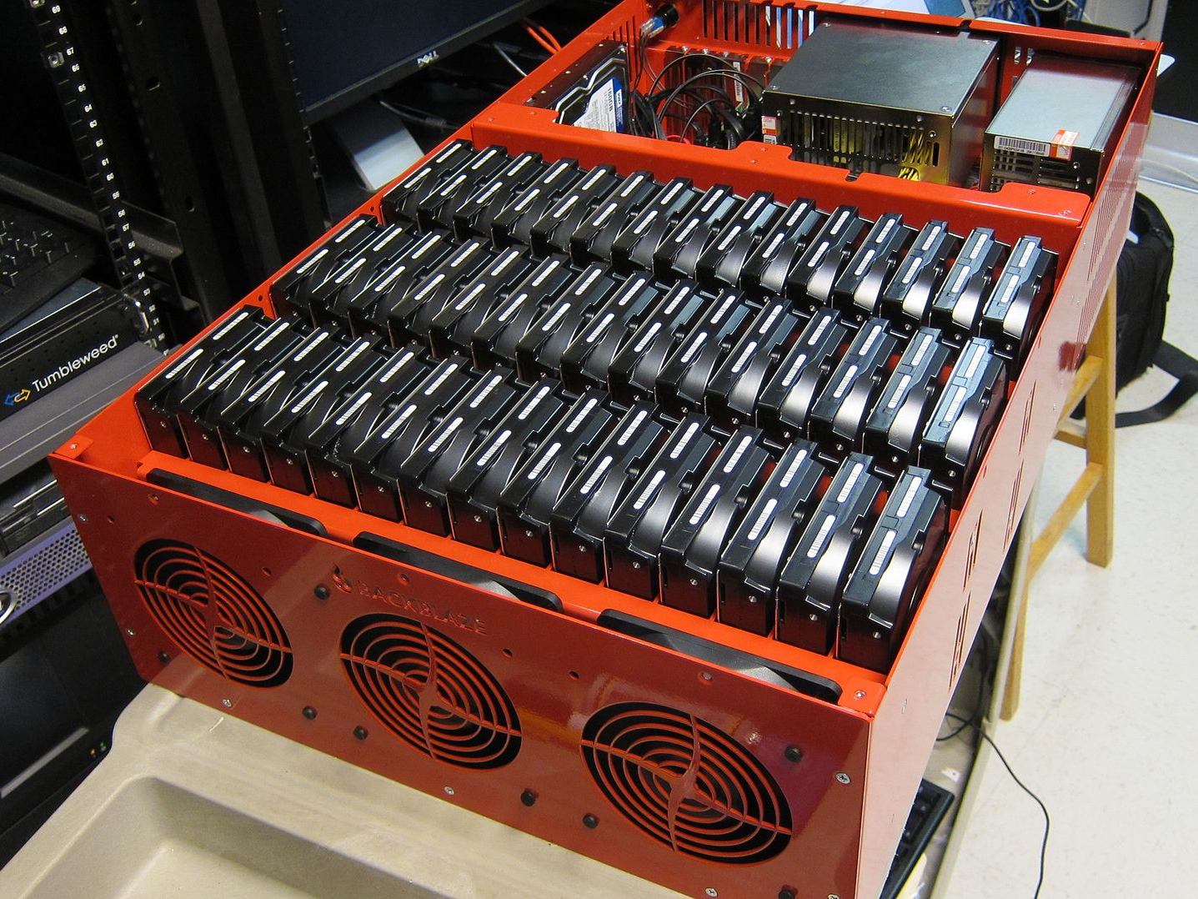
Source : https://www.backblaze.com/

Slide 6

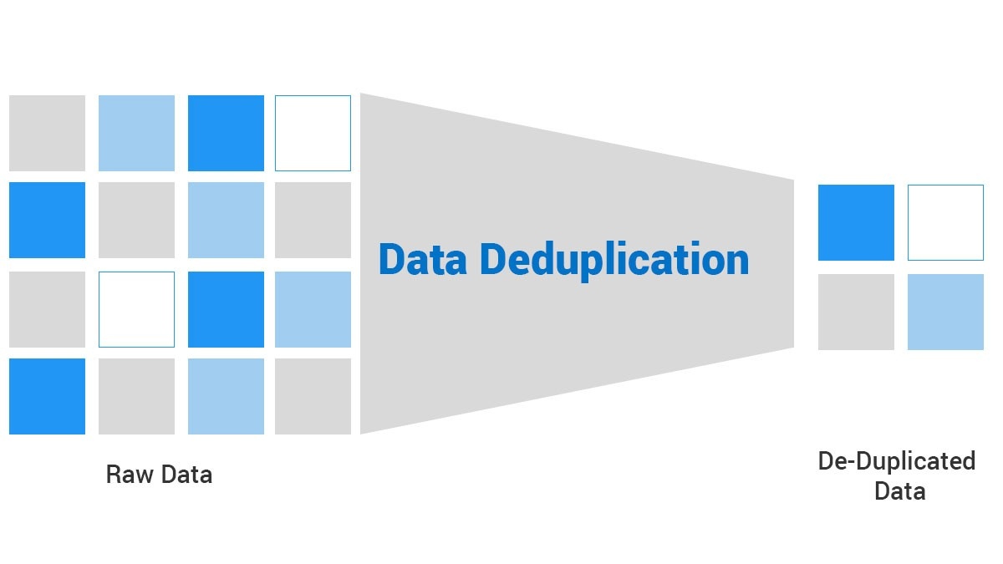
Source : https://www.thegioimaychu.vn/blog/thuat-ngu/deduplication/

Slide 7
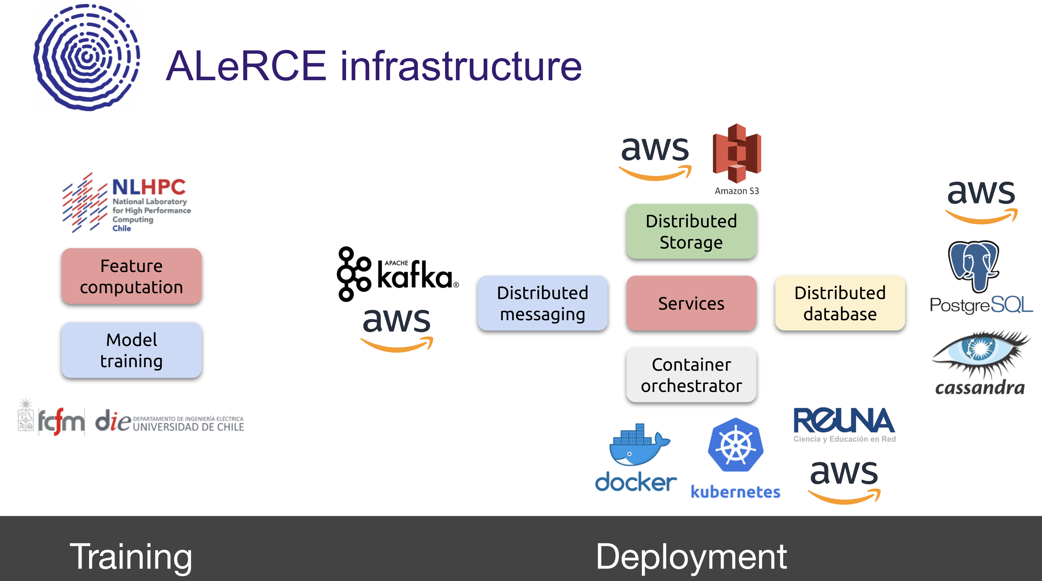
Source: https://alerce.science

Slide 8
« Why software is eating the world » (M. Andreesen, WSJ, 2011)
Source: https://www.wsj.com/articles/SB10001424053111903480904576512250915629460

Slide 9


Slide 10


Slide 11
“Only four languages maintain the same energy and time rank (OCaml, Haskel, Racket, and Python), while the remainder are completely shuffled.”
when manipulating strings with regular expression, three of the five most energy-efficient languages turn out to be interpreted languages (TypeScript, JavaScript, and PHP),
“Although the most energy efficient language in each benchmark is almost always the fastest one, the fact is that there is no language which is consistently better than the others,”
R. Pereira et al. SLE 2017
Energy efficiency across programming languages: how do energy, time, and memory relate?

Slide 12
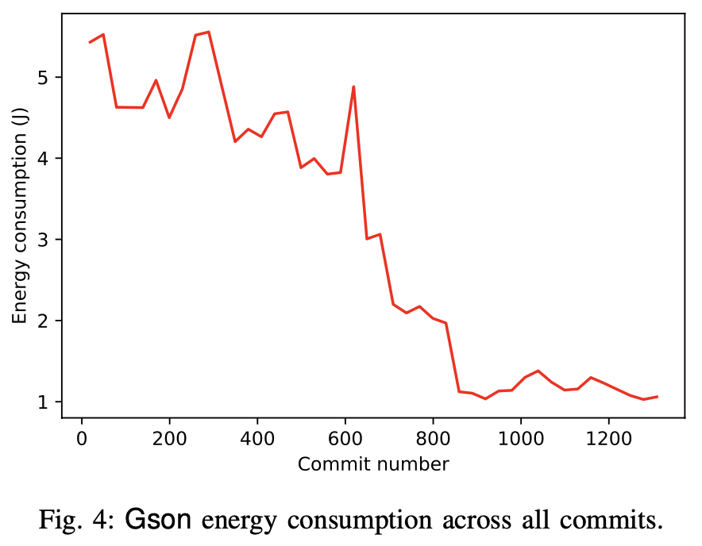
Z. Ournani, R. Rouvoy, P. Rust, J. Penhoat. Tales from the Code #1: The Effective Impact of Code Refactorings on Software Energy Consumption. 16th International Conference on Software Technologies (ICSOFT), July 2021.

Slide 14
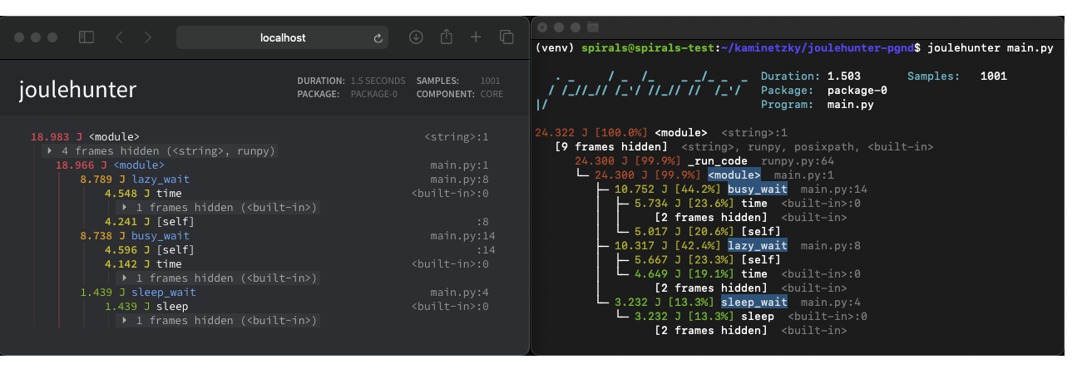
Energy profiling with JouleHunter
https://pypi.org/project/joulehunter/

Slide 15
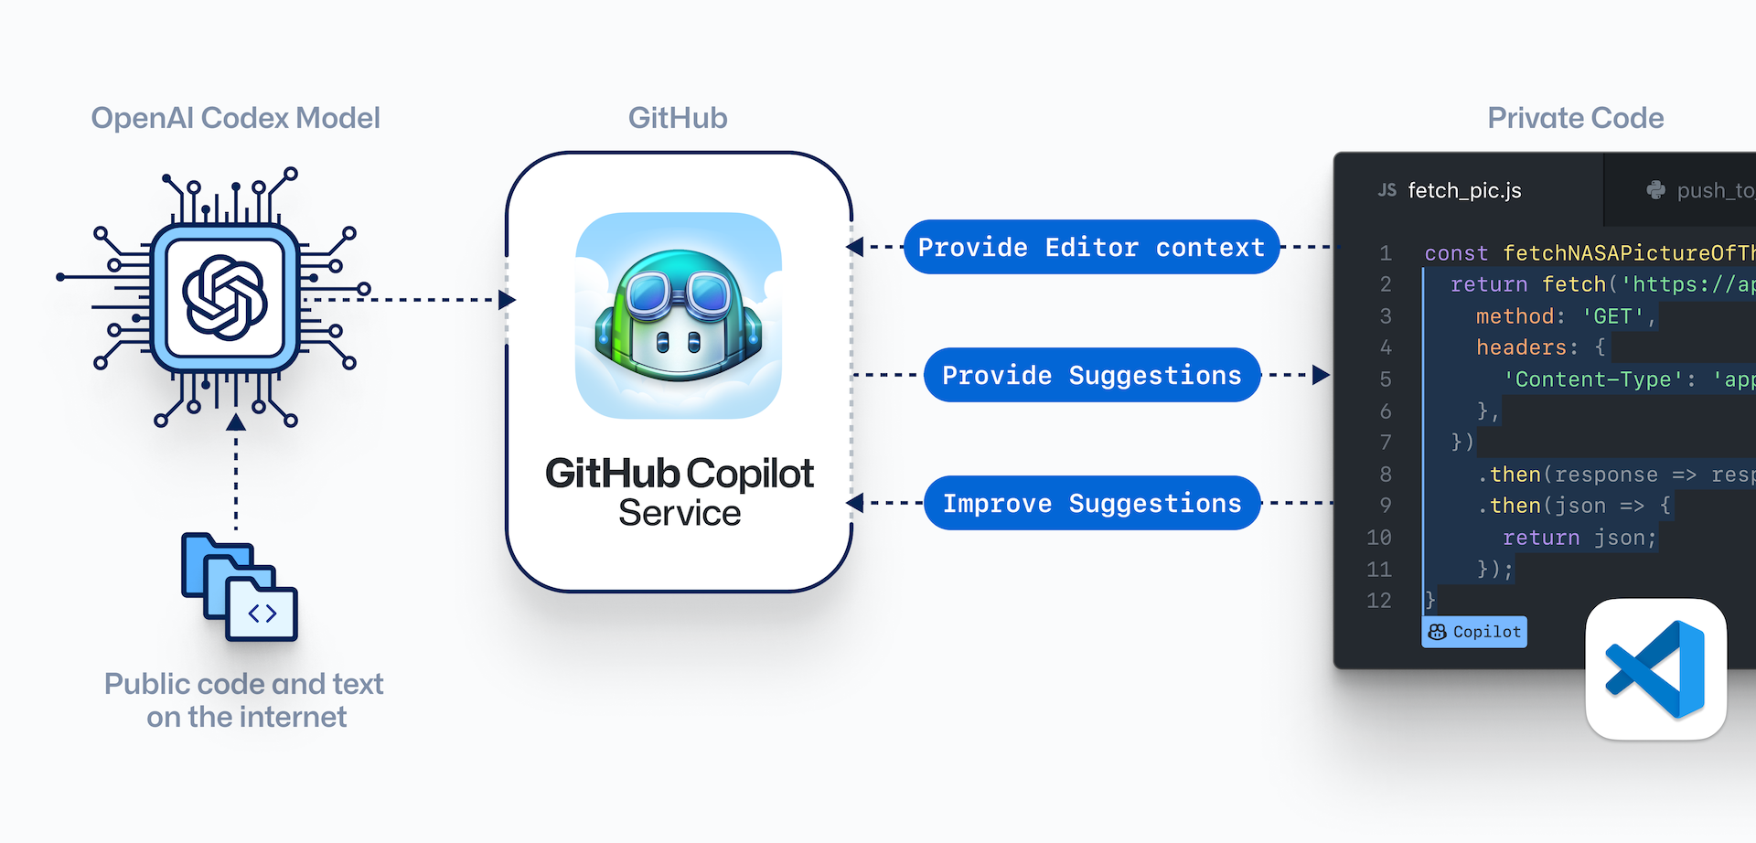
https://copilot.github.com

Slide 16

«Software Ate The World, Now AI Is Eating Software »
(M. van Attekum, J. Mei & T. Singh, Forbes, 2019)
Source: https://www.forbes.com/sites/cognitiveworld/2019/08/29/software-ate-the-world-now-ai-is-eating-software/

Slide 17
Source: https://alerce.science

Slide 18
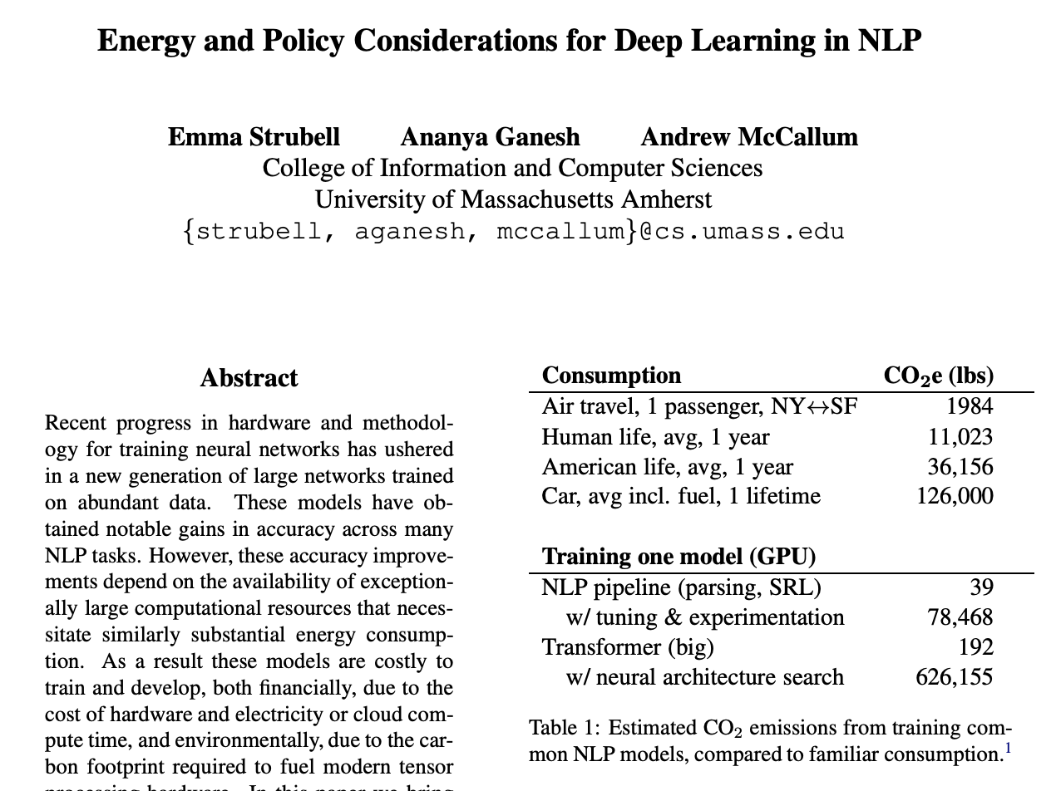
https://arxiv.org/abs/1906.02243

Slide 19
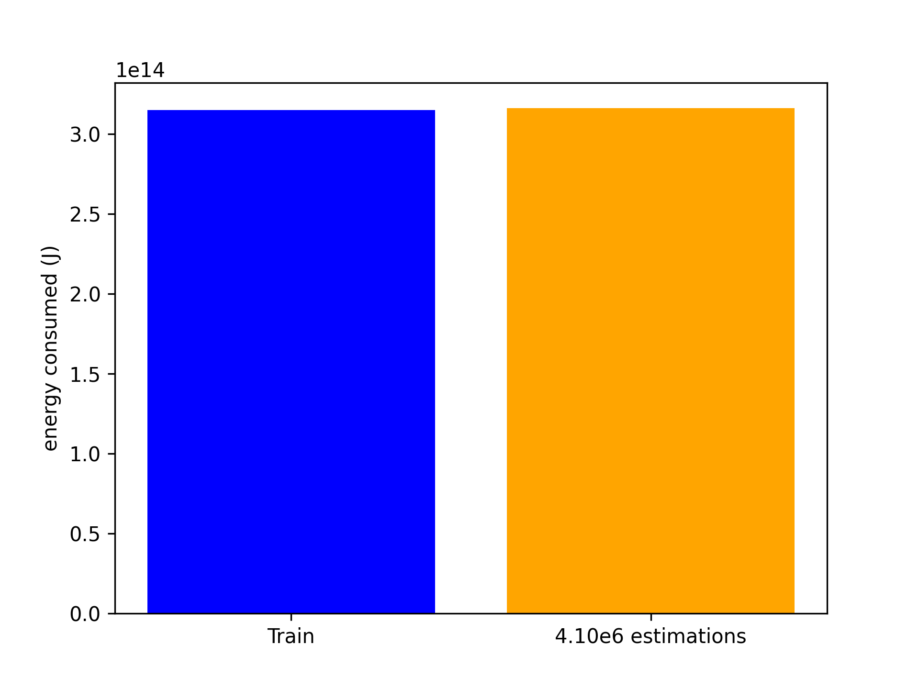
Energy consumed by training Vs. prediction
Gradient Boosting Classifier
4,1 millions d’estimations pour 1 entraînement…
https://scikit-learn.org/stable/modules/generated/sklearn.ensemble.GradientBoostingClassifier.html

Slide 20
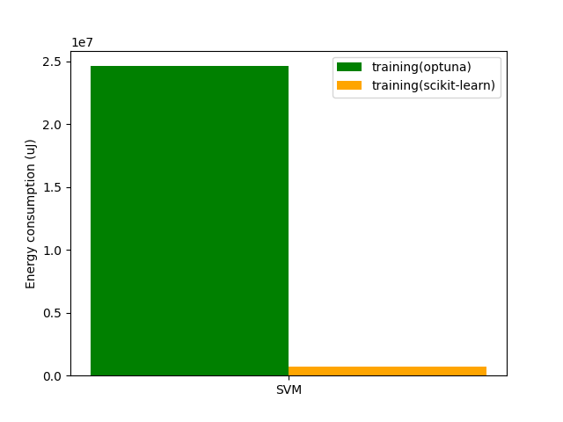
25x plus d’énergie pour optimiser quelques hyper-paramètres…

Slide 21
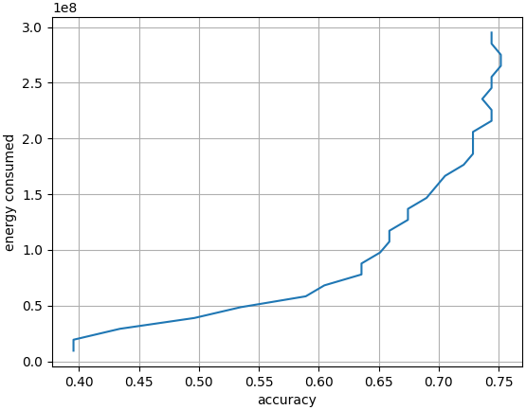
Cost of training a SVM classifier
2x more energy to gain 0.1 of accuracy…
https://scikit-learn.org/stable/auto_examples/applications/plot_face_recognition.html

Slide 22
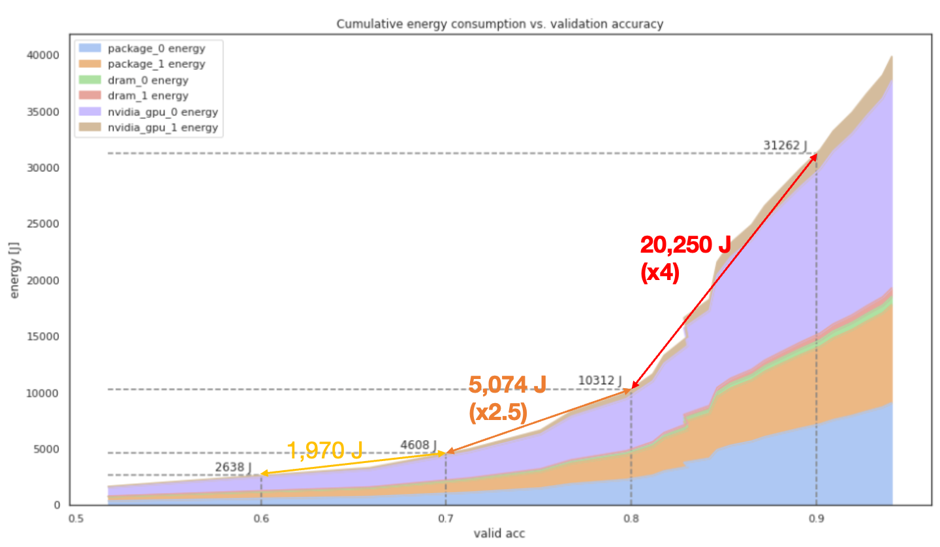

Slide 23
Source: https://alerce.science

Slide 24
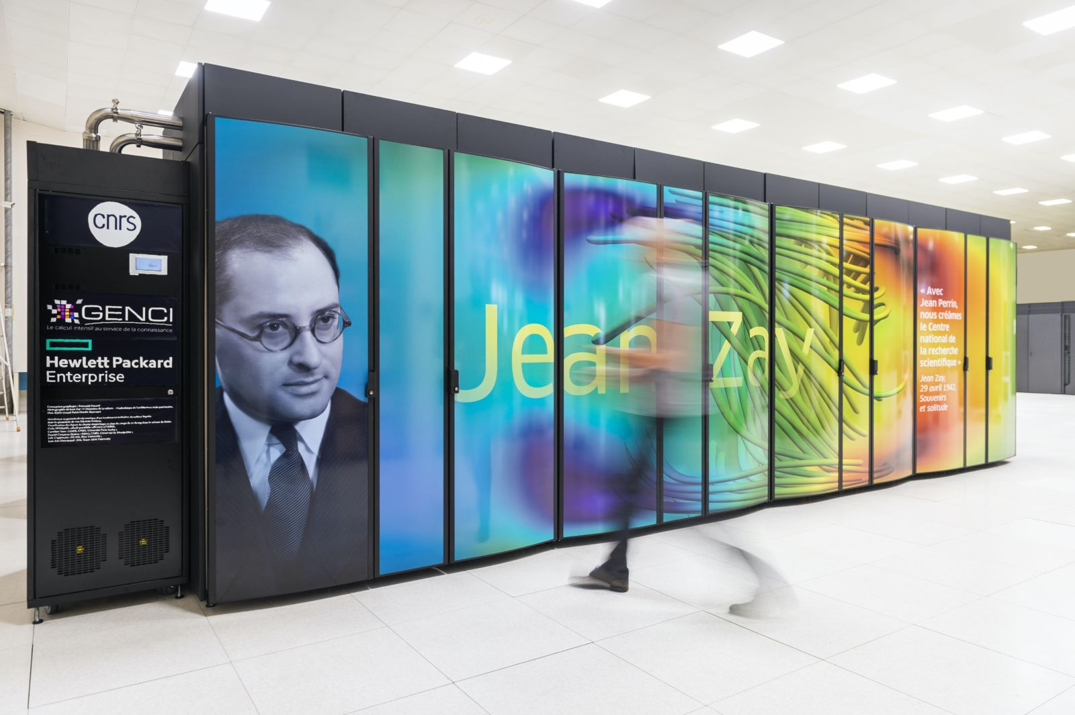

Slide 25
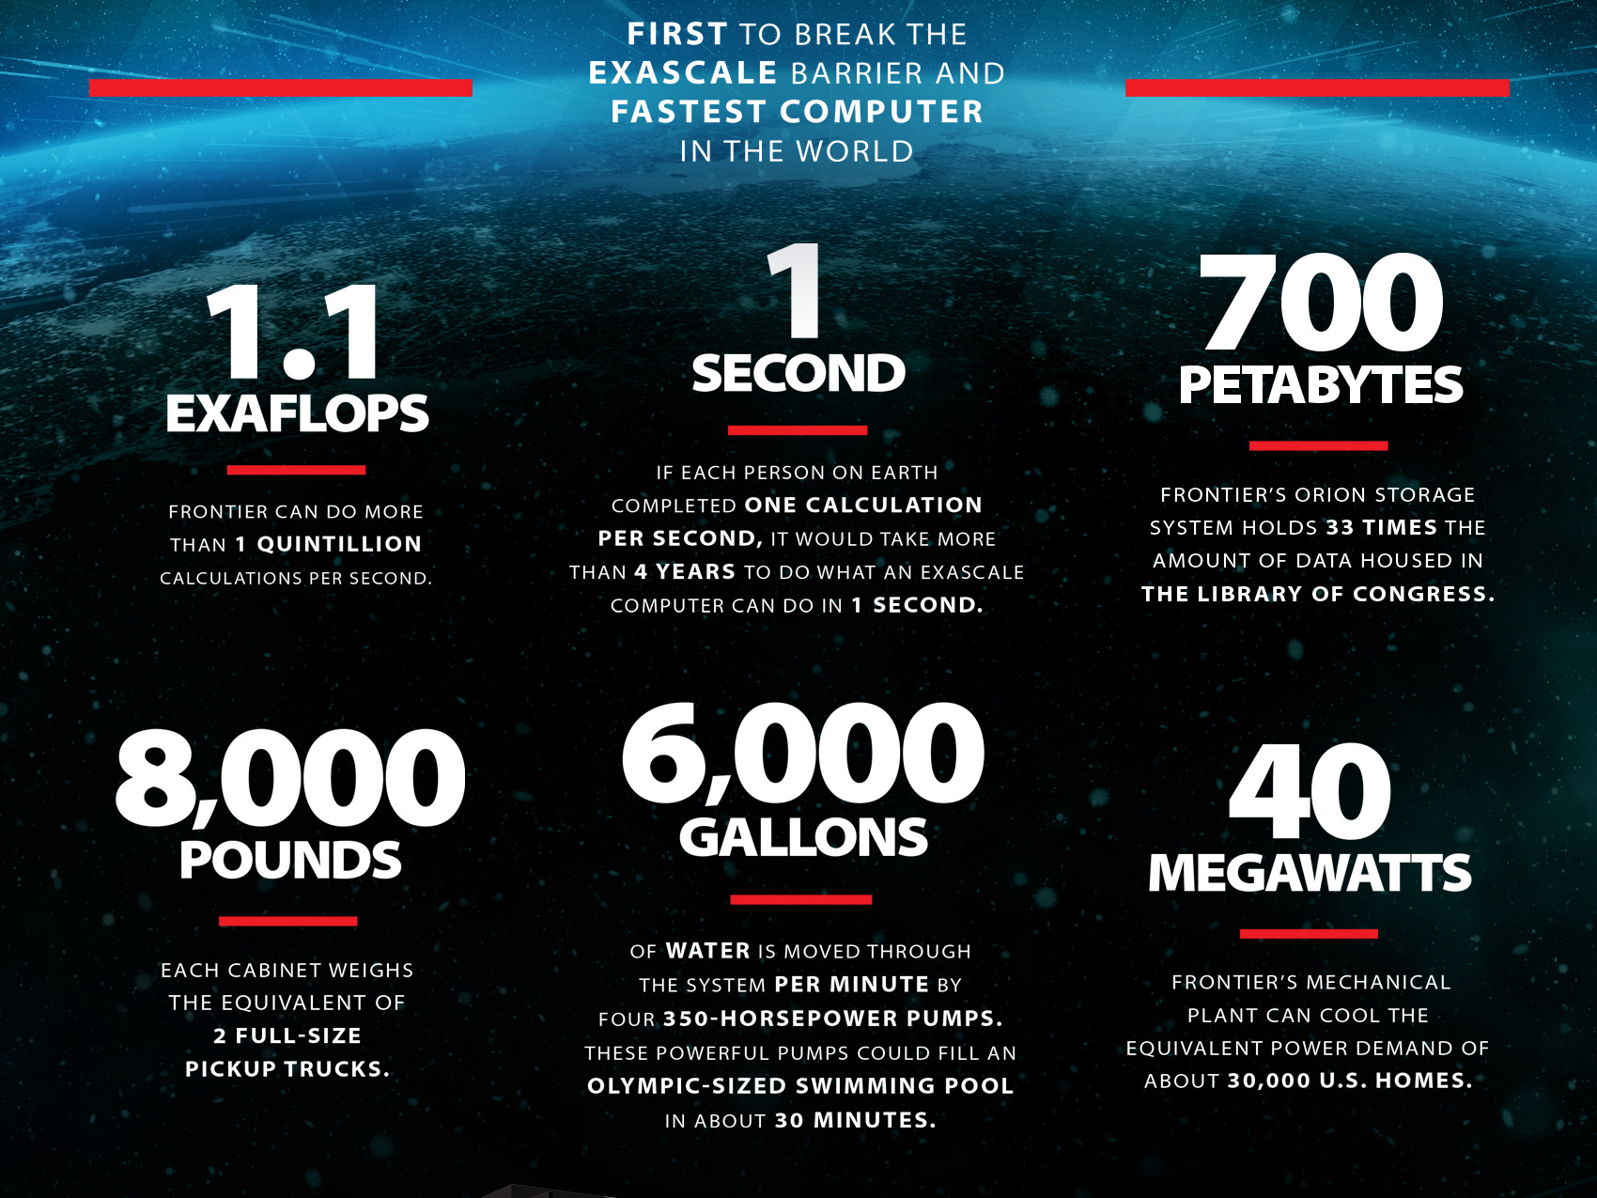

Slide 26
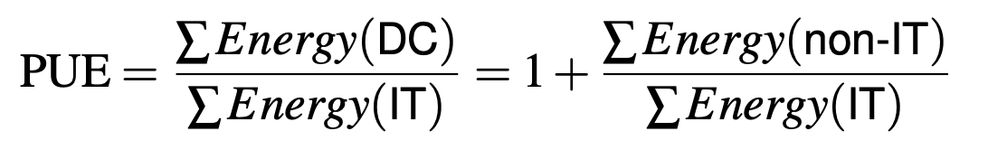

Slide 27
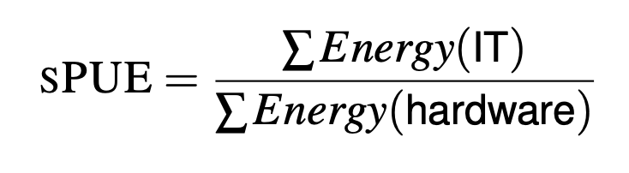
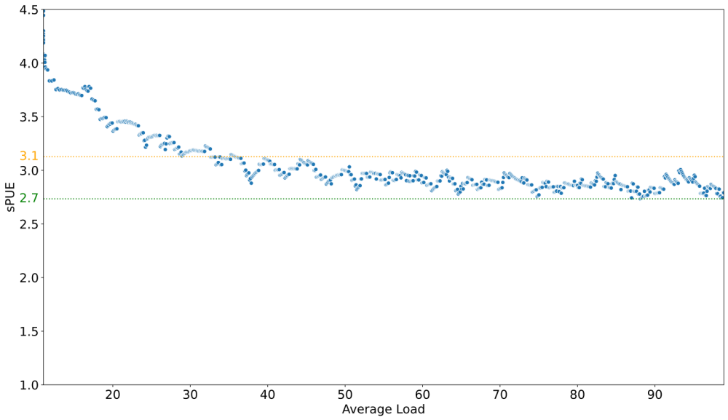

Slide 28
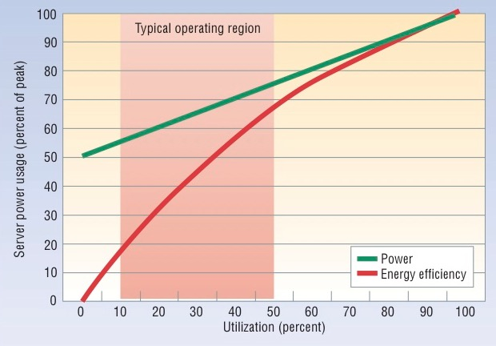
L. A. Barroso, U. Hölzle: The Case for Energy-Proportional Computing. IEEE Computer 40(12) 2007
CloudGC

Slide 29
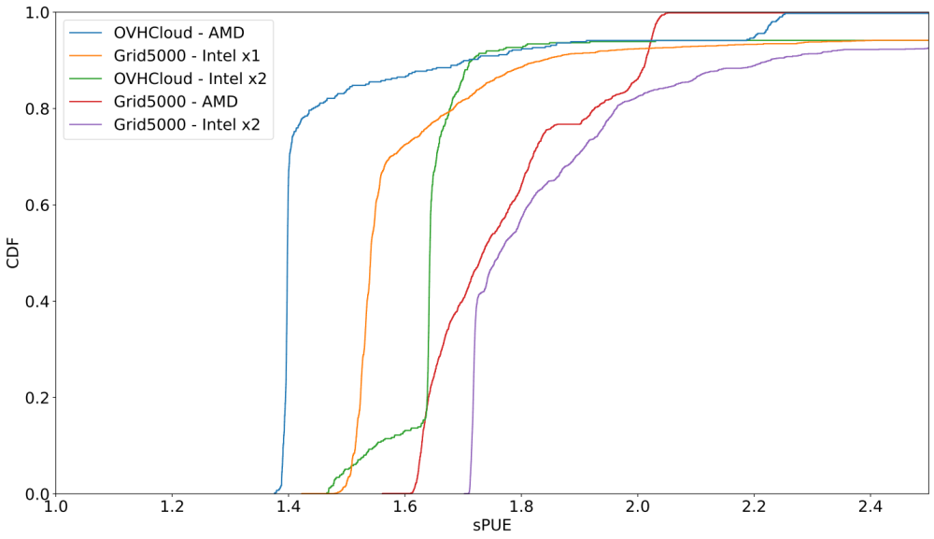
ANR HdF Résilience GreenAct (Inria, OVHcloud)

Slide 30
Pooling
Virtualization
Under the (cl)hood….

Slide 31
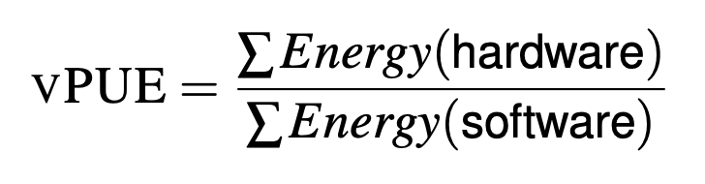
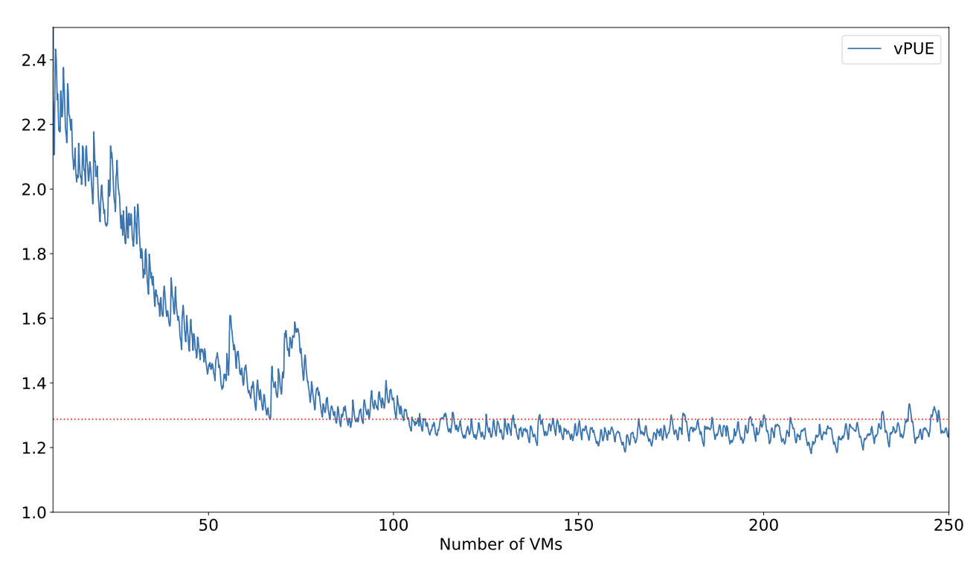

Slide 32

« These results show that these programmers lacked knowledge of how to accurately measure software energy consumption. »
Enabling power monitoring of software systems
http://powerapi.org

Slide 33
Complex Hardware Architectures

Slide 34
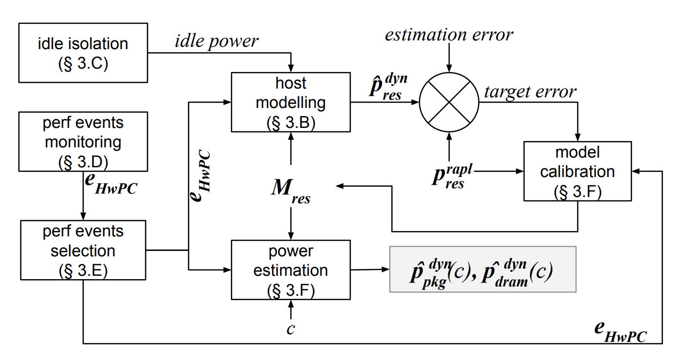
Learning the CPU/DRAM power models from RAPL
Feature selection
Regression model
Online learning
SmartWatts

Slide 35
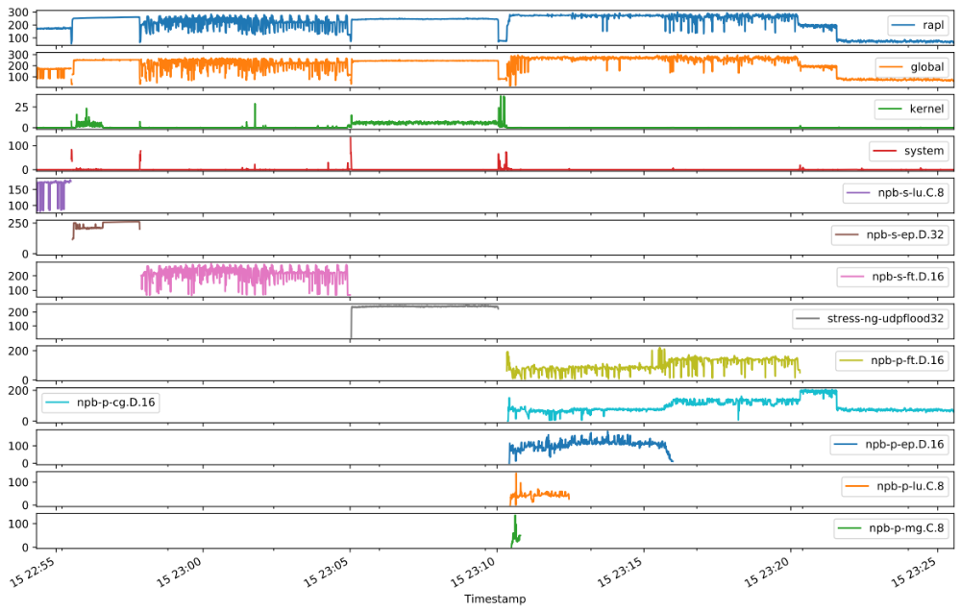
Monitoring the power consumption in real-time
SmartWatts

Slide 36
Source: https://alerce.science

Slide 37
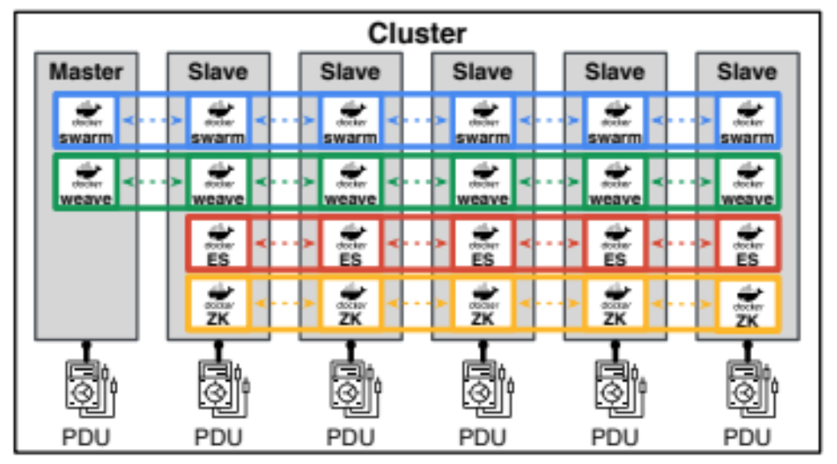
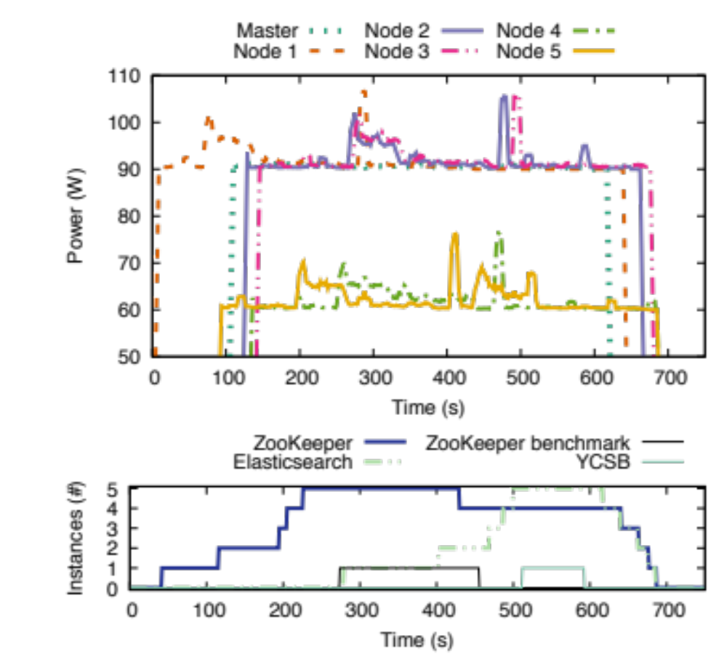
WattsKit

Slide 38
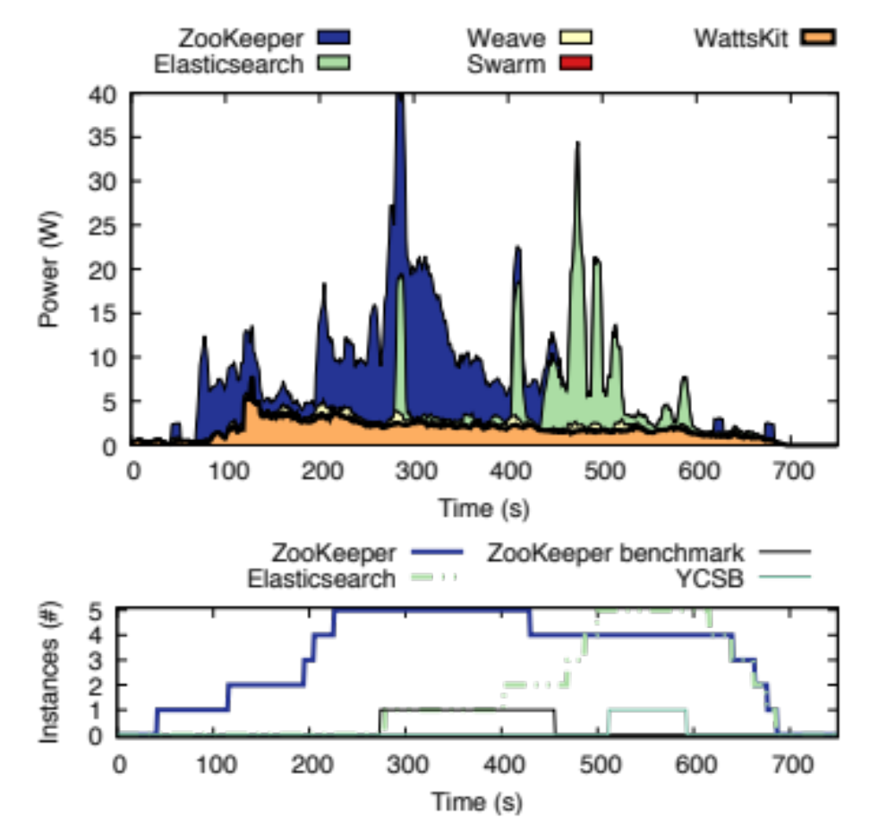
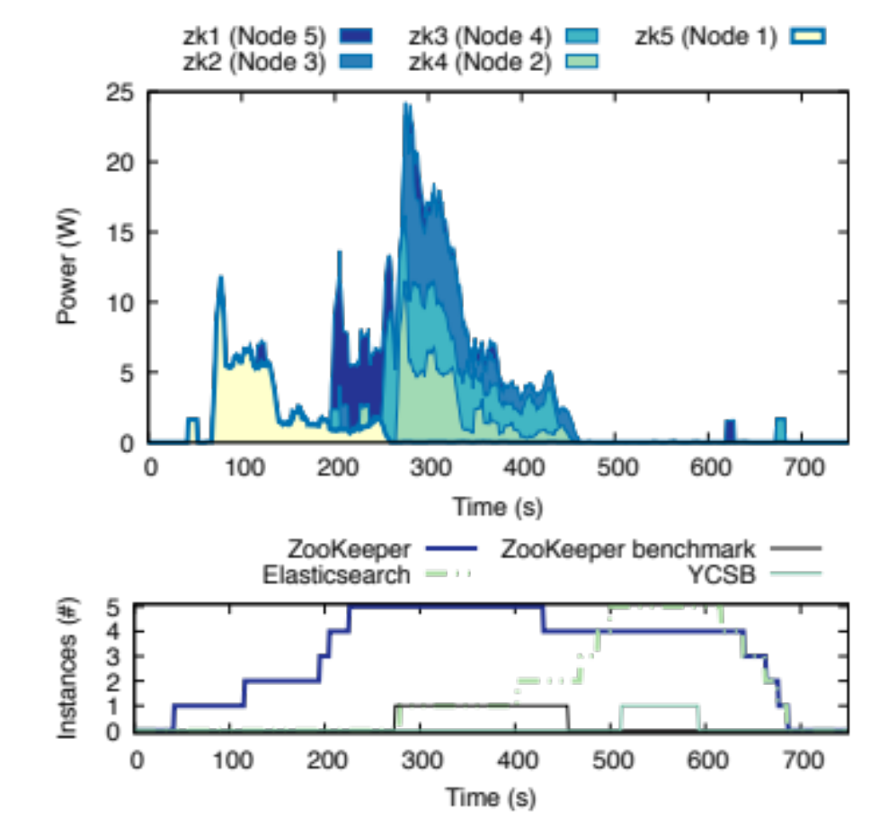
WattsKit

Slide 39
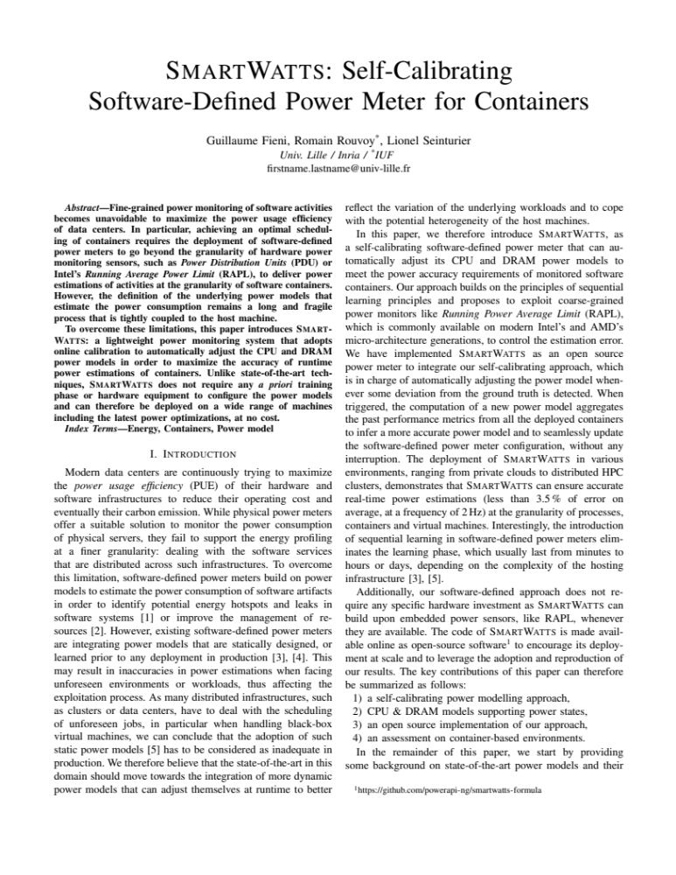
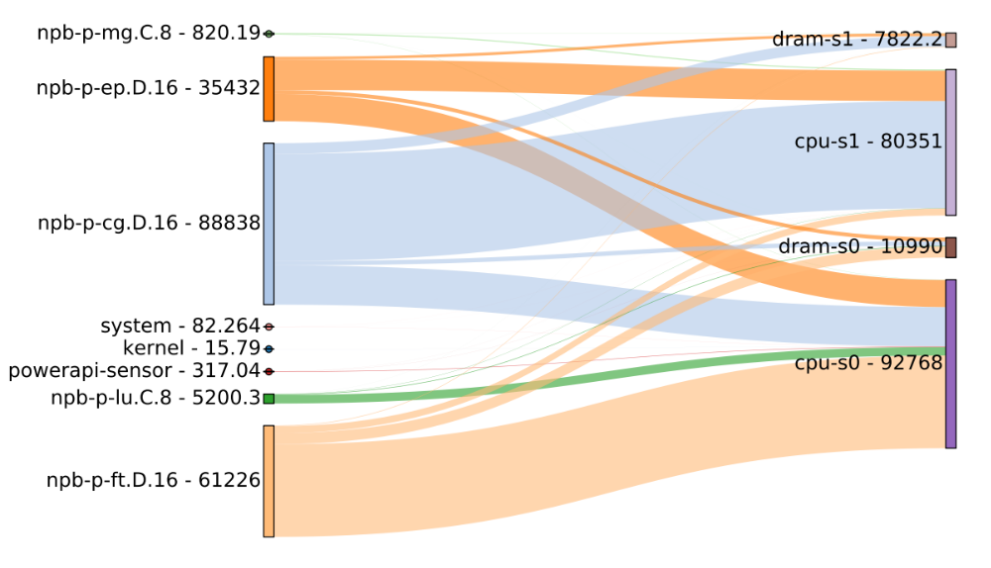
Understanding the distribution of energy among software
Software
Hardware
SmartWatts

Slide 40
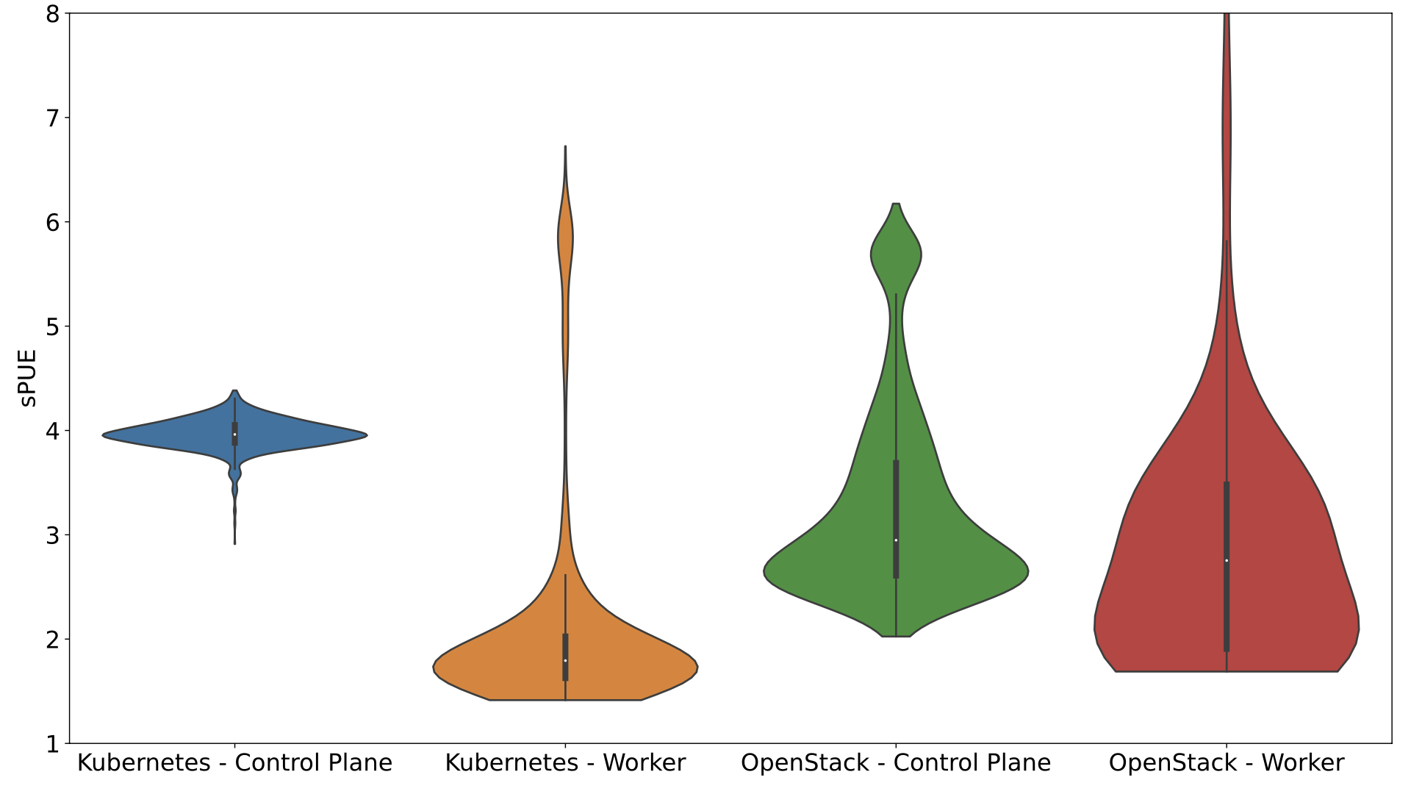

Slide 41

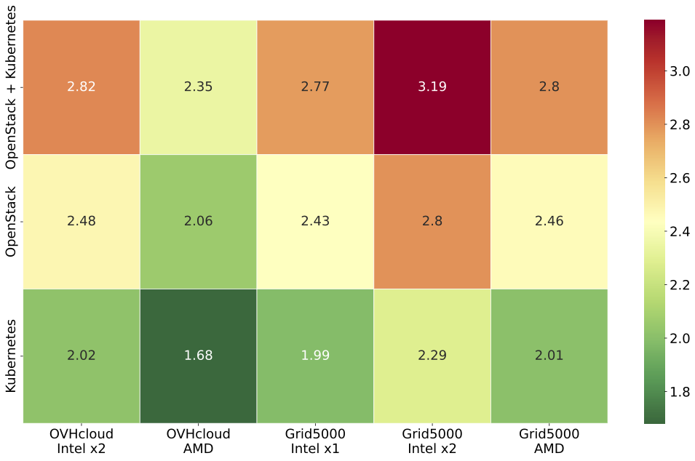

Slide 42

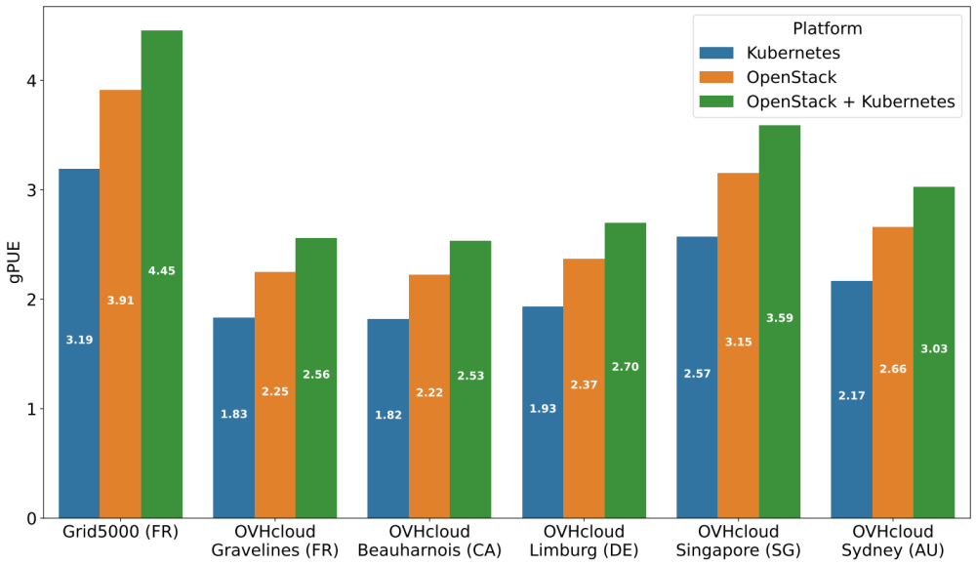

Slide 43
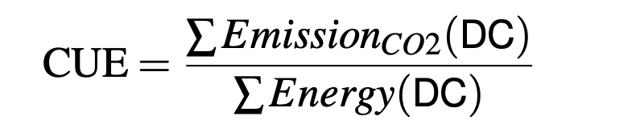

Slide 44

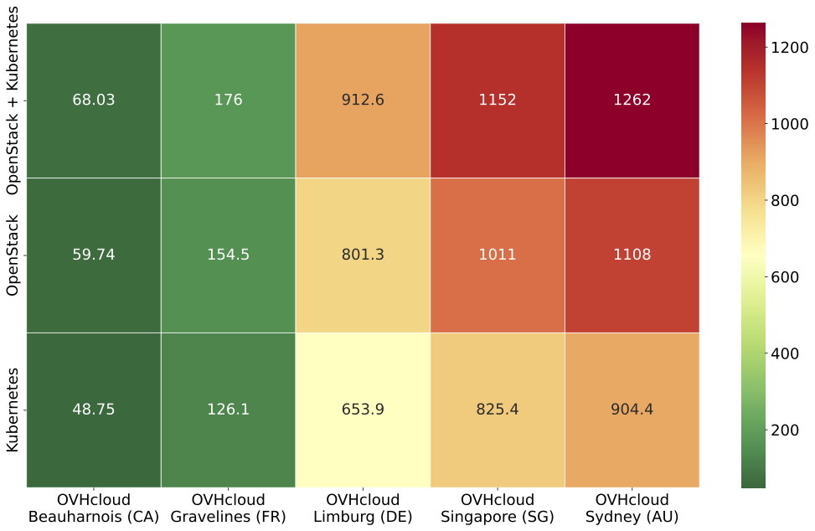
26 CO₂e
1 CO₂e
ANR HdF Résilience GreenAct (Inria, OVHcloud)

Slide 45


App
Framework
JVM
Container
Kubernetes
Inefficient / wasted resources
Guest operating system
Virtual machine
Hypervisor
Operating system
Hardware
Energy / environment footprint
https://commons.wikimedia.org/wiki/File:Pyramide_khephren.jpg

Slide 46



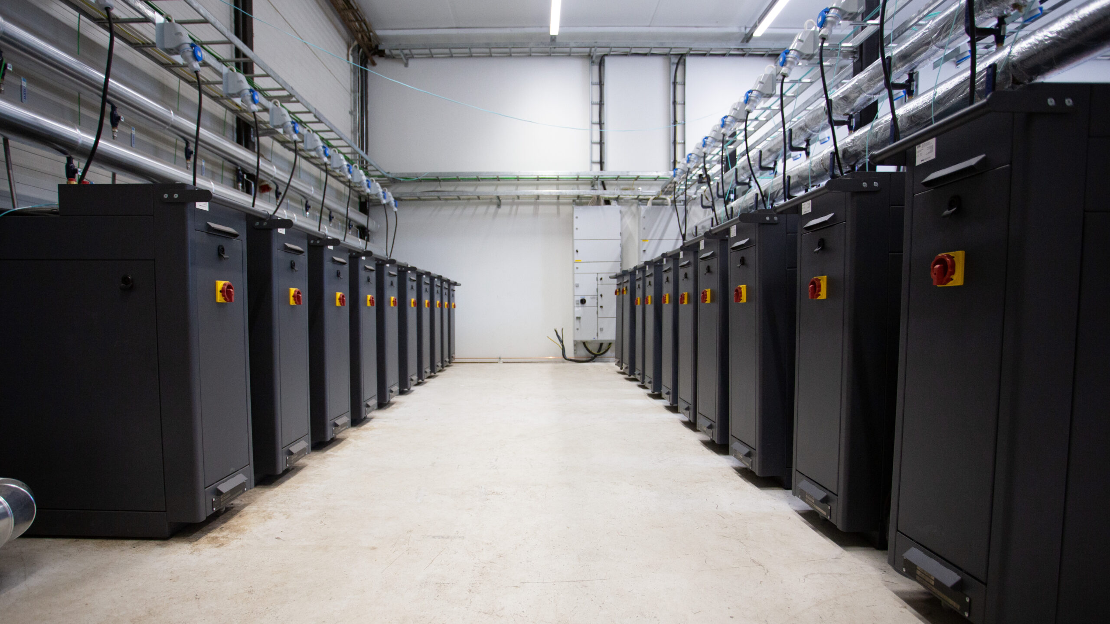

Slide 47
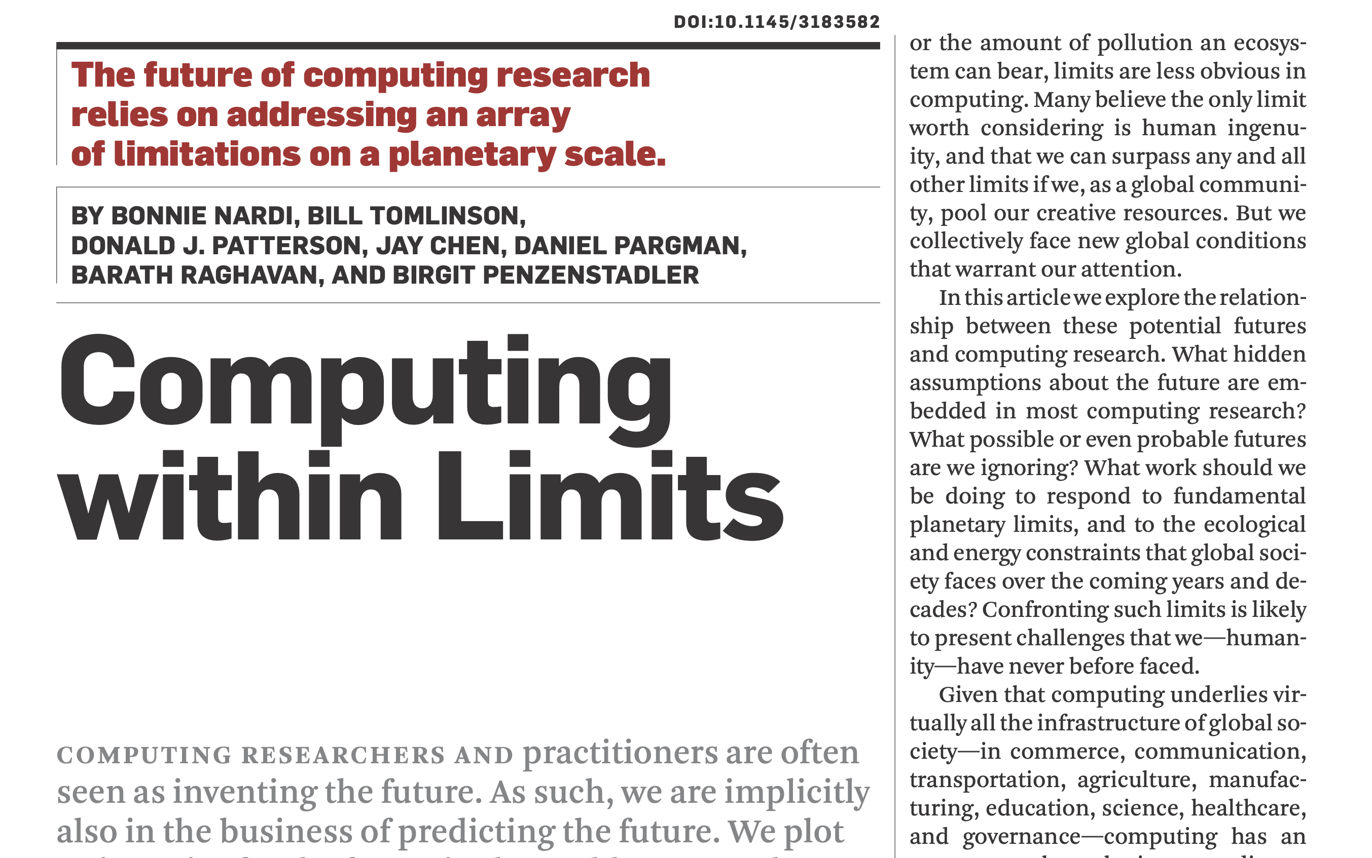
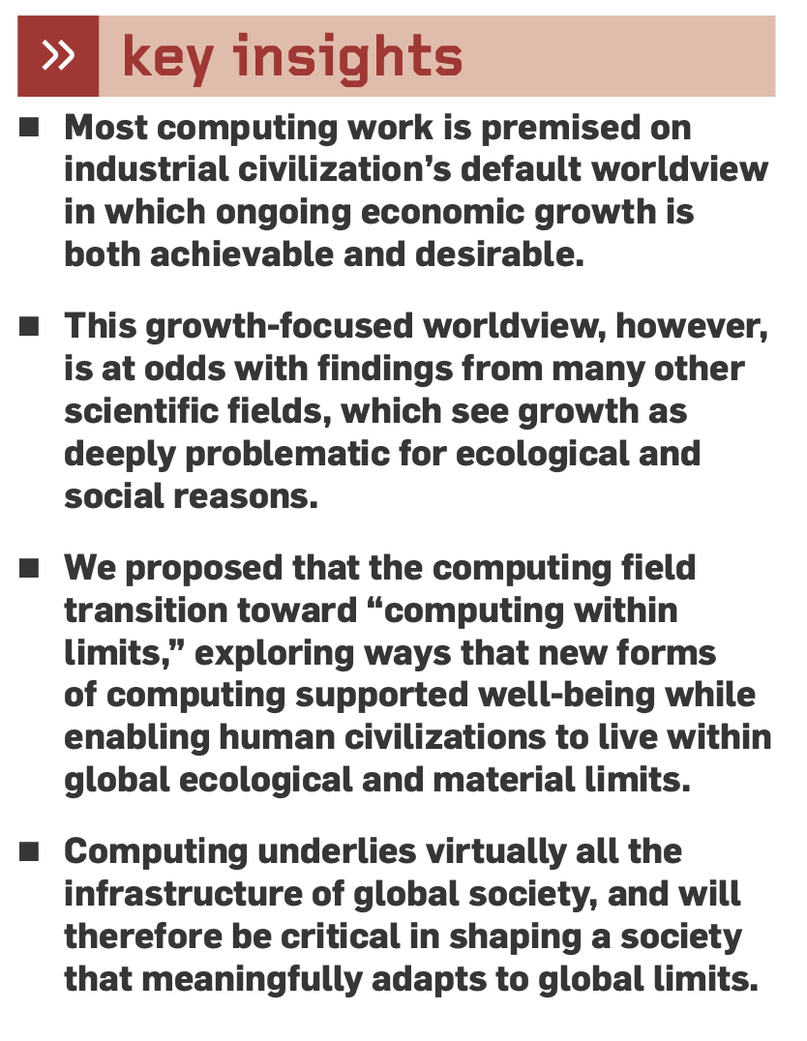
https://computingwithinlimits.org/

Slide 48
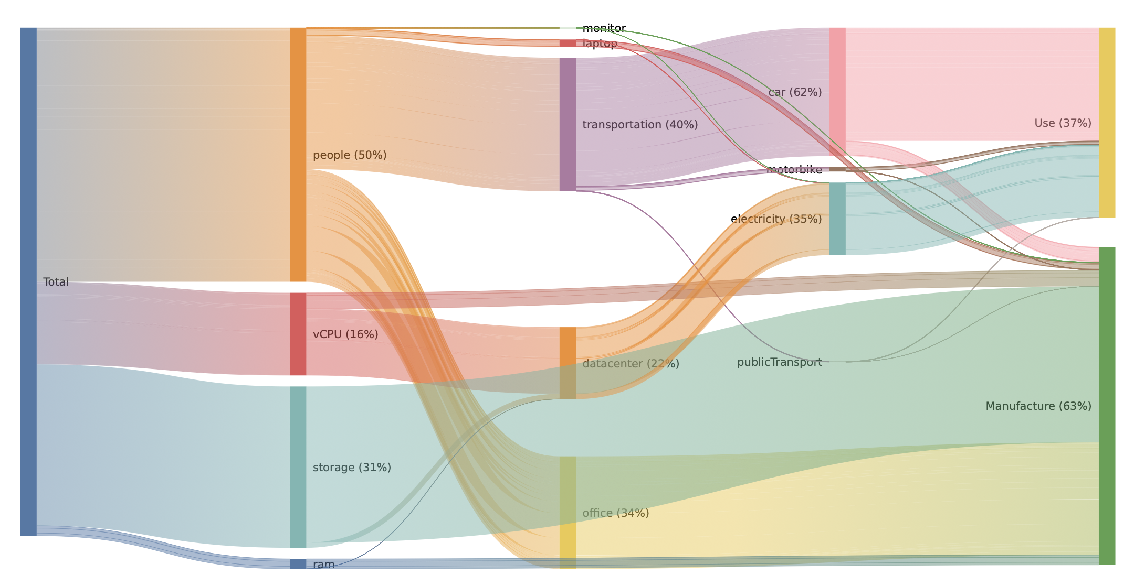
Environmental cost of delivering software services
Uncovering the Environmental Impact of Software Life Cycle. T. Simon, P. Rust, R. Rouvoy, J. Penhoat. International Conference on Information and Communications Technology for Sustainability, Jun 2023
ANR PRCE Distiller (Inria, OVHcloud, Orange, Davidson consulting) – https://distiller.cloud/

Slide 49
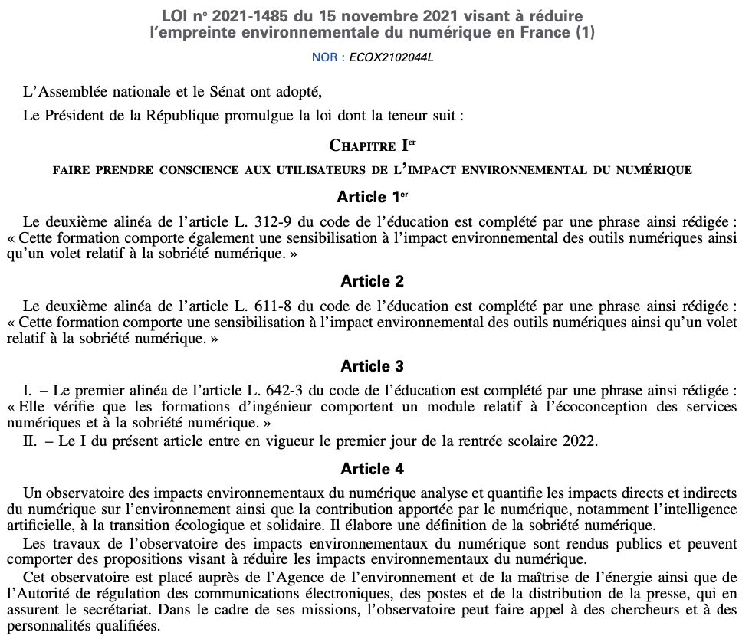
Loi REEN: https://www.legifrance.gouv.fr/jorf/id/JORFTEXT000044327272

Slide 50
Challenges for research organisations
Software is eating the world, and beyond
  Everything is software-defined
  Producing software for anything is a serious threat
  Needs to reason about all (environmental) impacts
Needs to work on all the layers of an infrastructure
  Each layer = a software to optimize
  Optimizing layers may increase resource consumption
  Needs to cope with potential rebound effects
Software engineering should digest (upcoming) AI tools
  AI challenges humans to focus on expert tasks
  AI comes with a (environmental) cost to pay
  Needs to think about sustainable AI applications

Slide 52
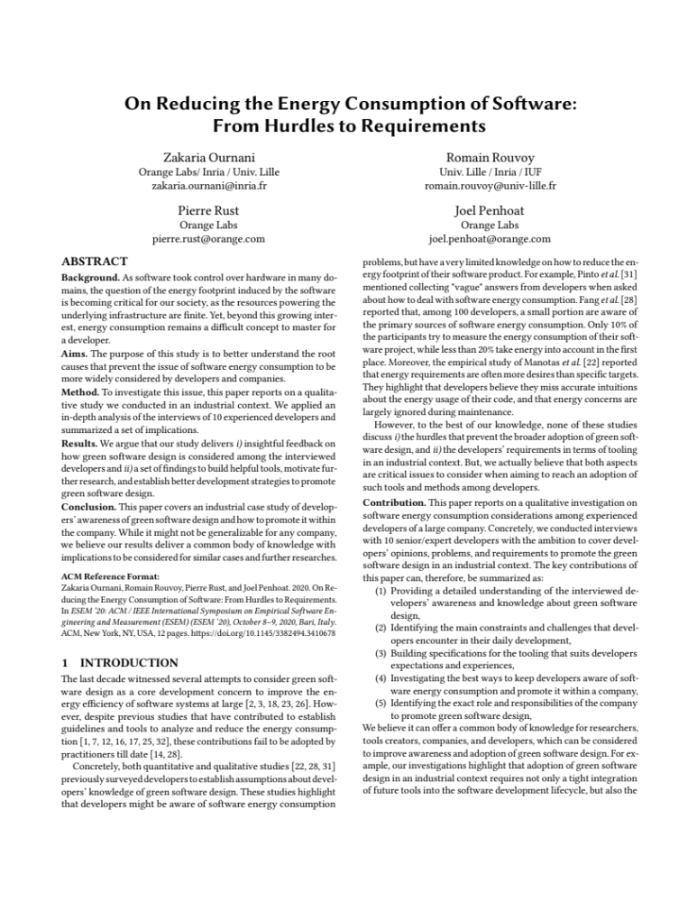
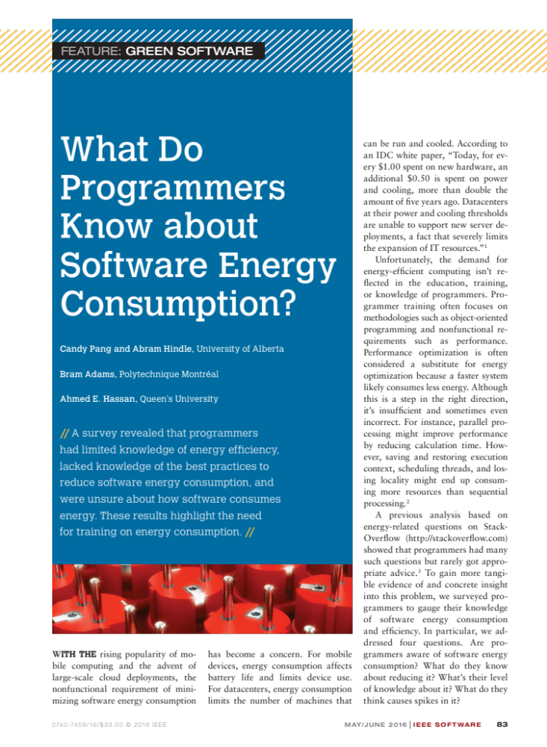
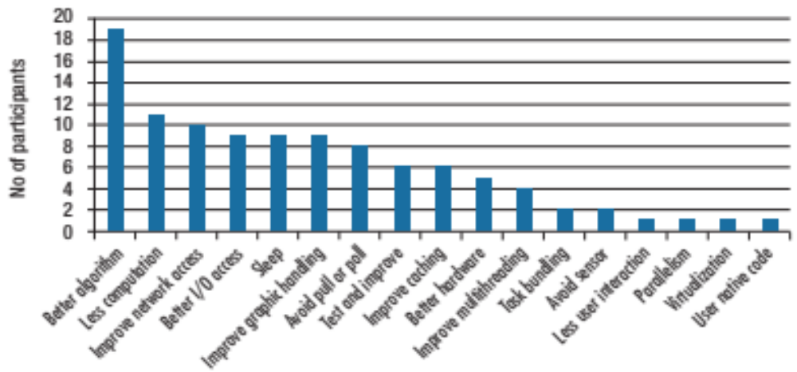
[…] clients “care first and foremost about speed of development, and secondly about reasonable quality and performance.”
“It’s more often the hardware rather than the software that we are in- terested in when we talk about en- ergy consumption.”
These results show that these programmers lacked knowledge of how to accurately measure software energy consumption.
http://doi.org/10.1109/MS.2015.83

